Slide 1







19TH SFG(A) TXARNG
18x Brief
SWTD
SF Recruiting
Notes:
This presentation is a product that can be used to target 19yr old+ individuals with a targeted audience-highschool/collegiate athlete

Slide 2
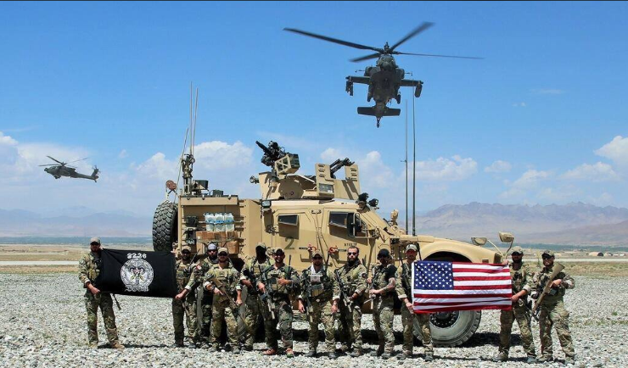
“YOU ONLY DIE ONCE”
I PROTECT THE NATION WITHOUT FEAR,
WITHOUT FAIL, WOITHOUT EQUAL!!!
Notes:
Reference ARSOF 2035

Slide 3

SPECIAL FORCES WINNING MINDSET
Humans are more important than hardware
Quality is better than quantity
Special Operations Forces cannot be mass produced
Competent Special Operations Forces cannot be created after emergencies occur
Notes:
SOF Truths
Humans are more important than hardware
Quality is better than quantity
Special Operations Forces cannot be mass produced
Competent Special Operations Forces cannot be created after emergencies occur
Most special operations require non-SOF support
-What is our overall goal and strategy

Slide 4

WHO AND WHAT WE WANT
INTEGRITY
ADAPTABILITY
COURAGE
PERSONAL
RESPONSIBILITY
PERSAVERANCE
TEAM PLAYER
PROFESSIONALISM
CAPABILITY
Notes:
SOF Attributes

Slide 5
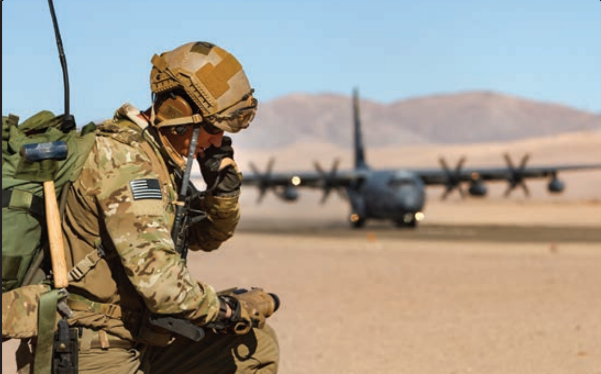
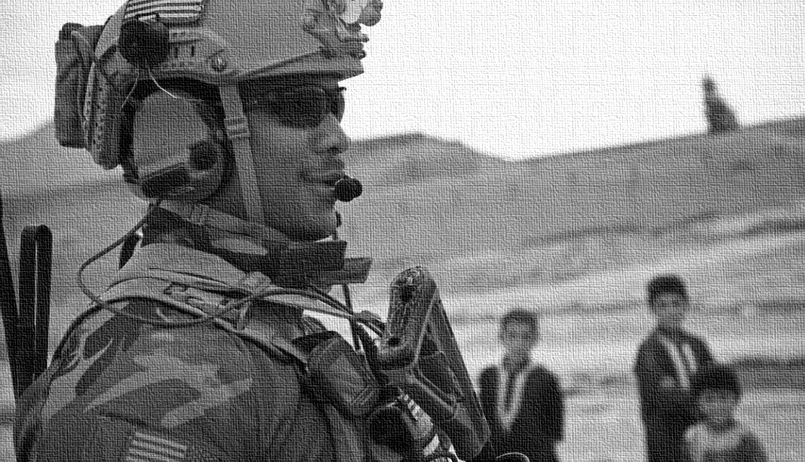

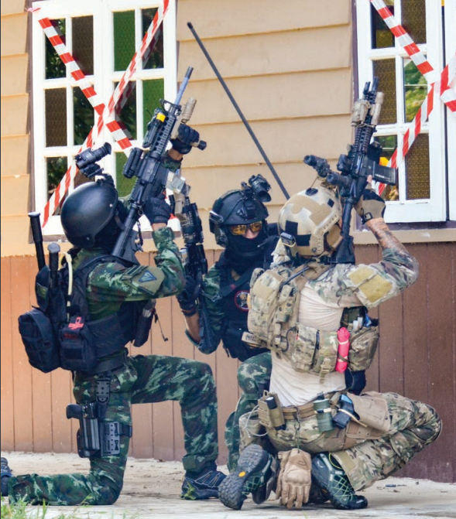
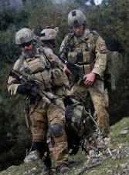
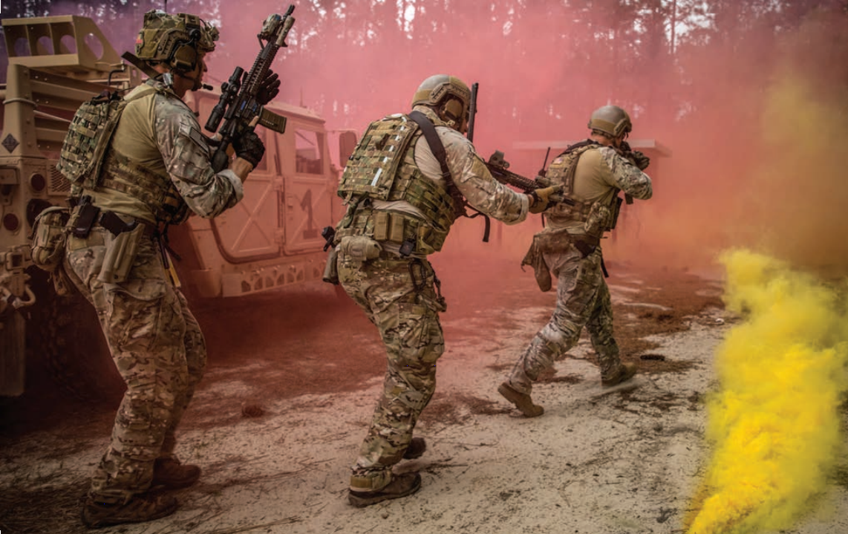
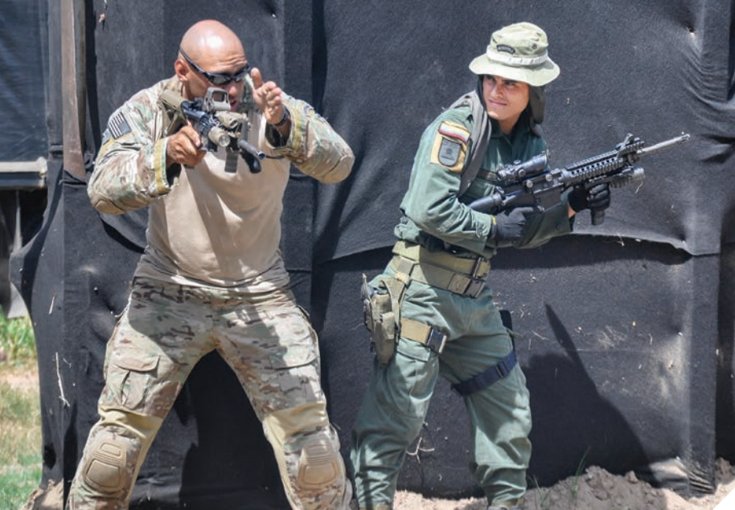

WHO AND WHAT WE WANT
INTEGRITY
ADAPTABILITY
COURAGE
PERSONAL
RESPONSIBILITY
PERSAVERANCE
TEAM PLAYER
PROFESSIONAL
CAPABILITY
Notes:
SOF Attributes

Slide 6

SPECIAL FORCES “ONE TEAM ONE FIGHT”
Notes:
SFODA Fighting Configuration

Slide 7
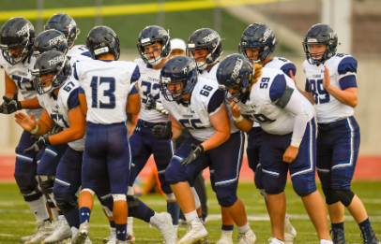
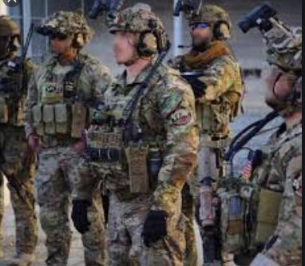
SPECIAL FORCES “ONE TEAM ONE FIGHT”
Notes:
SFODA Fighting Configuration

Slide 8



BENEFITS
Education Benefits - GI Bill/Hazelwood/Yellow Ribbon/TA
Healthcare/Dental
Full Military Pay while on active orders
Monthly Drill Pay when you get to your unit
Networking Opportunities
Retirement
Notes:
Benefits

Slide 9

BENEFITS
Consider alternative paths to College and Work Careers
$5,035 – Avg. Annual Tuition at Major Universities in Texas
$15,000 - $37,000 – Avg. Annual Tuition at Private Universities
$35,000+ - Avg. amount of debt a college graduate will leave with
ATTEND COLLEGE WITHOUT CRUSHING DEBT
Notes:
Benefits

Slide 10
BENEFITS
Provides significant financial benefits for Students
Eligible for Tuition Assistance – Up to $4,500 a year for Tuition
Post 9/11 GI Bill – 36-45 mos. Tuition & Fees paid and receive on avg. $2,000 a month for housing while in college.
Notes:
Benefits

Slide 11
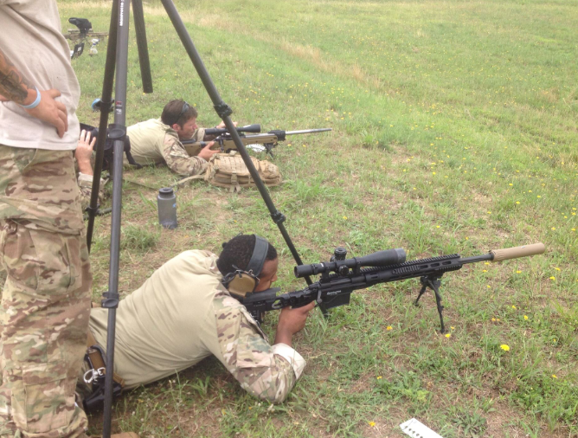
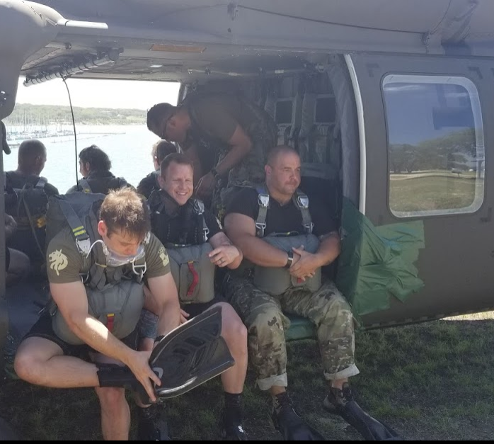

JOIN THE BROTHERHOOD
MAJOR GLENN SETTLES - SWTD
SERGEANT “TJ” - SWTD
SERGEANT “JT” – SF RECRUITING
512.638.7308
glenn.t.settles.mil@mail.com
512.638.7308
theodossois.j.maroulis.mil@mail.mil
512.638.7308
NG.TX.TXARNG.LIST.RR-SF@mail.mil
Notes:
Benefits

Slide 12
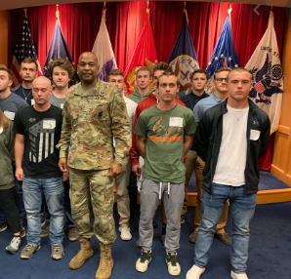

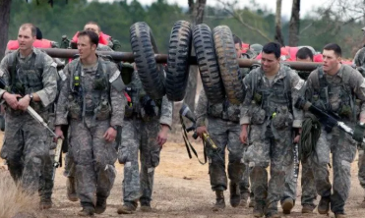

AFTER YOU COMMIT
YOUR PIPELINE – 3 to 4 mos
MEPS Infantry Basic Training Special Forces Assessment Airborne School
Notes:
Pipeline after commitment

Slide 13
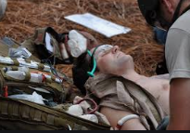

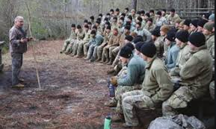


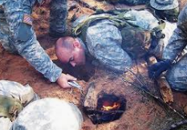
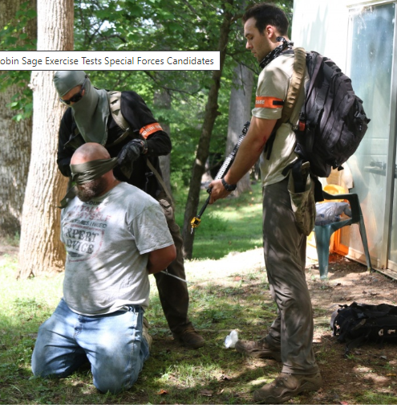
AFTER YOU COMMIT
YOUR PIPELINE – 12 to 20 mos
Special Forces Qualification Course
Specialty Training
Tactical Training
Language Training
Unconventional Warfare
Notes:
Pipeline after commitment

Slide 14
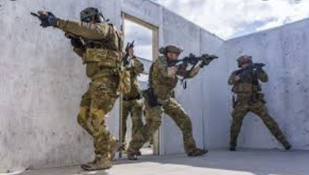

AFTER YOU COMMIT
YOUR PIPELINE – 12 to 20 mos
SPECIAL FORCES QUALIFICATION COURSE
GRADUATION – DON YOUR “GREEN BERET”
Notes:
Pipeline after commitment

Slide 15


“ONE SHOT ALL SKILL”

